Slide 1

Stem cell transplantation: the problem
The Bad Boys
Sleepy immune cells

Slide 2
Stem cell transplantation: the problem
Some immune cells become Bad Boys by simply growing uncontrollably. These are tumor cells. In principle, the normal immune cells would recognize these Bad Boys and kill them. But the Bad Boys may not be seen as Bad by the immune system that then keeps sleeping.

Slide 3
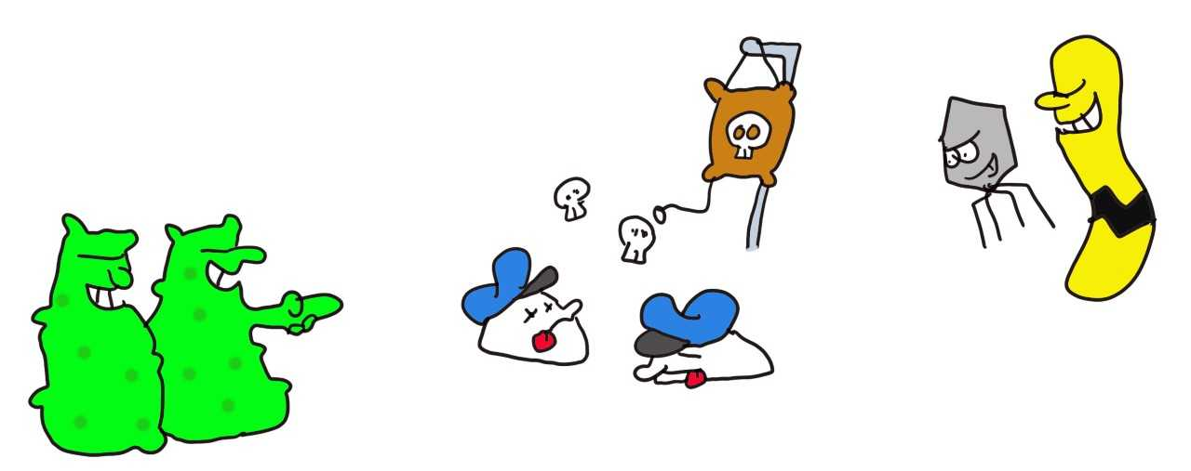
Stem cell transplantation: the treatment
Remove the
sleepy immune cells
Viruses
love this
The Bad Boys

Slide 4
Stem cell transplantation: the treatment
So the idea is to remove the sleeping immune cells and replace these with new immune cells from a donor that has almost the same HLA molecules. But then first the sleeping immune cells have to be removed. The Bad Boys don’t care but viruses and bacteria love this phase of treatment as they have a chance to grow quickly while the donor’s immune cells begin to expand.

Slide 5
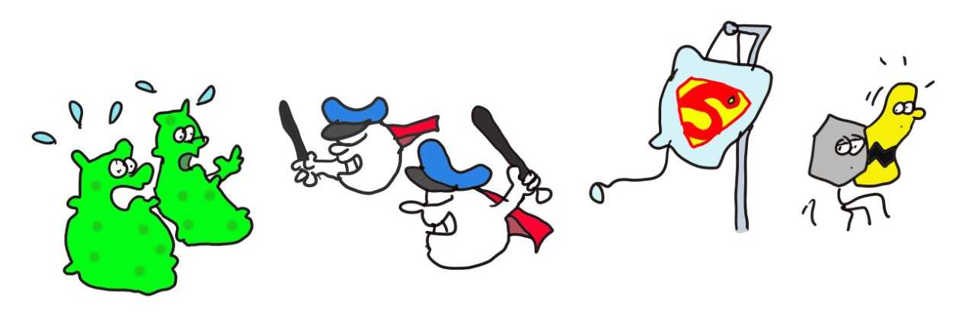
Stem cell transplantation: the solution
Donor Superman
immune cells
Running away
viruses
The Bad Boys

Slide 6
Stem cell transplantation: the solution
Then new immune cells from the donor are introduced that do recognize the Bad Boys and thus kill the tumor. In addition, also viruses and bacteria are recognized. Patients are then living with the immune system of the donor to control the Bad Boys and infections.

Slide 7
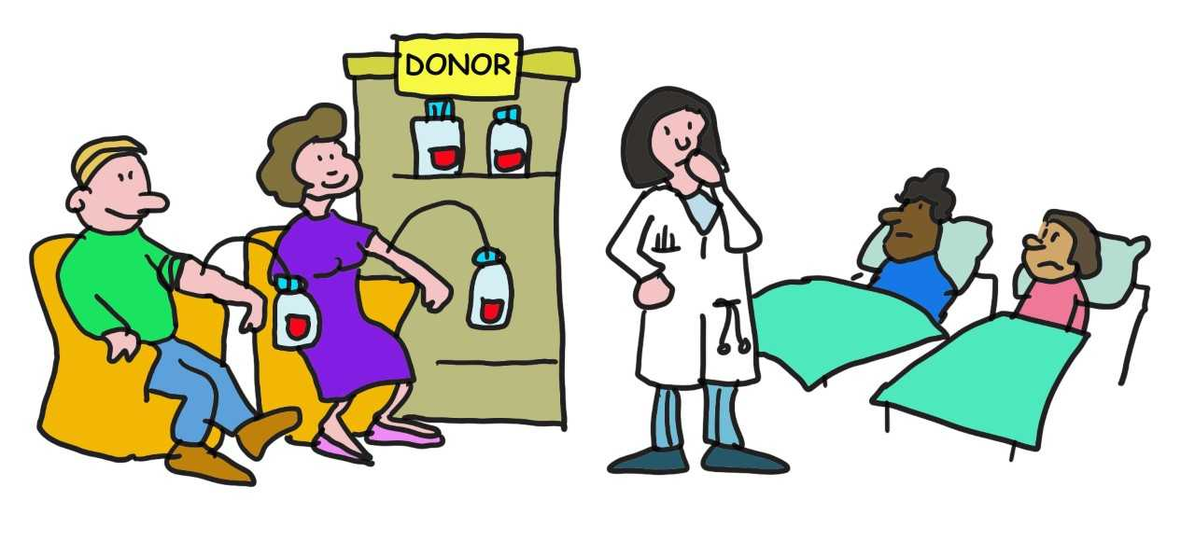
Stem cell transplantation: how to treat everyone?
Not optimal donors
for these patients
Optimally HLA matched patients

Slide 8
Stem cell transplantation: how to treat everyone?
There is one issue. The differences between the donor and recipient (the patients) should be very small. Otherwise, the donor’s immune system starts attacking all organs of the patient, which can be life threatening. Essentially, this is a transplantation problem where the donor immune system goes out of control.
This is why it is important to have closely HLA matched donors and recipients. Since different populations have different HLA molecules, stem cell donors from every population are needed so that each patient has an equal opportunity to get the best and safest response regardless of their background. Otherwise Caucasian patients are best off as many more Caucasian donors are present in donor banks than other groups. Please see https://bethematch.org to find out how you can help solve this problem.

